Slide 1

Network Layer Routing Algorithm Distance Vector Routing
Lecture 12 | CSE421 – Computer Networks
Department of Computer Science and Engineering School of Data & Science

Slide 2

Objectives
understand principles behind network layer services:
routing algorithms
distance vector
link state

Slide 3
Autonomous Systems
Internet is divided into autonomous systems (AS).
An AS = a group of networks and routers controlled by one organization.
Routing inside an autonomous systems(AS) :intra-domain routing.
Routing between autonomous systems(AS) :inter-domain routing.

Slide 4
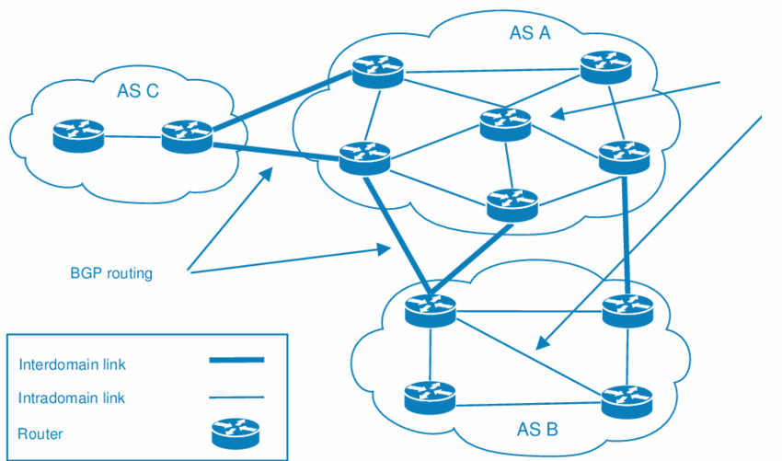
Autonomous Systems
RIP/ OSPF

Slide 5
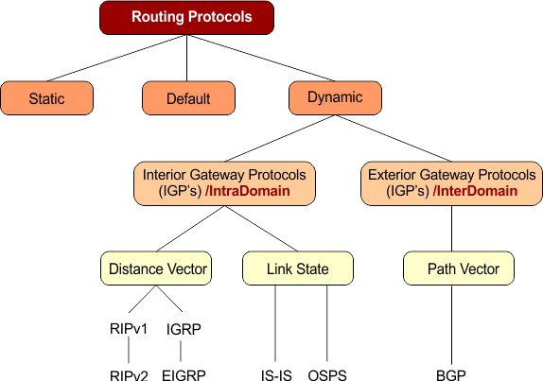
Popular Routing Protocols

Slide 6
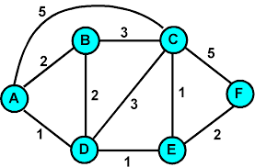
Routing Algorithms
Given a set of routers and links connecting the routers.
Routing algorithm finds a “good” path from the source to destination router.
Good path = Lowest cost path

Slide 7
Routing Algorithm classification
Global:
Every router knows the whole network (all nodes, all links, and their costs).
Each router builds a complete map (topology).
Uses link state algorithms (like Dijkstra’s shortest path).
Decentralized:
Each router only knows about its neighbors and the cost to reach them.
Routers share information with neighbors and update step by step.
Uses distance vector algorithms (like Bellman-Ford).

Slide 8
Distance Vector Algorithm

Slide 9
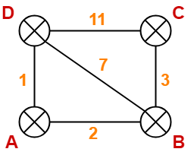
Distance vector algorithm
Based on Bellman-Ford Algorithm.
Each router finds shortest paths to all destinations.
Shortest path cost can be:
Hop count
Link delay
Bandwidth
Uses a weighted network (topology).
Notes:
‹#›

Slide 10
How Does It Work?
Each router keeps a Distance Vector (table).
Router shares its table with neighbors regularly.
When a router gets a table from a neighbor, it updates its own table using the Bellman-Ford rule.
Repeat until all routers know the shortest paths.
Notes:
‹#›

Slide 11
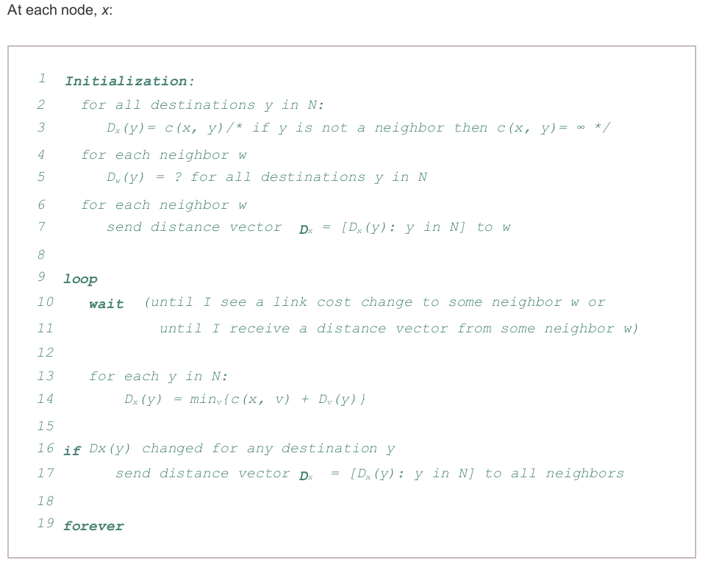
Algorithm
Notes:
‹#›

Slide 12
NODE D Table
NODE C Table
Node | Distance
A | 1
B | 7
C | 11
D | 0
Node | Distance
A | No Info
B | 3
C | 0
D | 11
12
Cost to A = cost(to neighbor) + neighbor’s cost(to destination)
D Router
Cost to A from D Router
11
+
1
Distance Vector Algorithm:
Cost to a destination = cost(to neighbor) + neighbor’s cost(to destination)

Slide 13
Periodic Updates of Distance Vector
Routers regularly send their entire routing table to neighbors (e.g., every 30 seconds in RIP).
These updates are sent even when there is no change in the network.
This is simple but inefficient.
Notes:
Inefficient: Updates consume bandwidth and router CPU resources.
Periodic updates are always sent even there have been no changes for weeks or months.

Slide 14
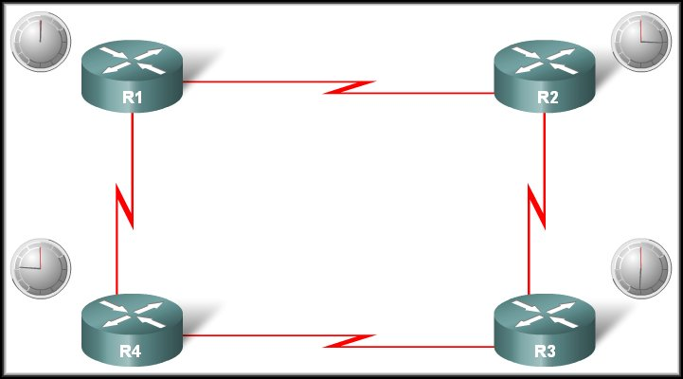

Operation of Distance Vector
Periodic Updates:
R1 Update Timer expires
Neighbour of R1
Updates sent.
Broadcast!
R1 is unaware of R3 and its networks
Neighbour of R1

Slide 15
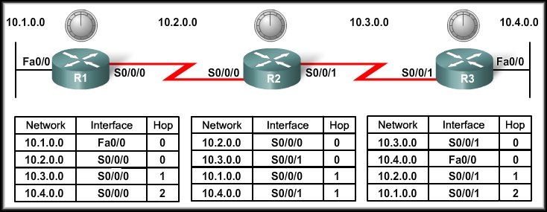
Distance Vector Routing Protocols
Network Discovery

Slide 16
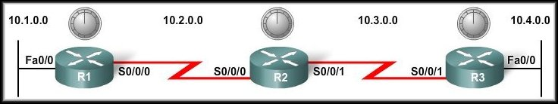
Cold Start
Network Discovery:
Is part of the process of the routing protocol algorithm that enables routers to learn about remote networks for the first time.

Slide 17
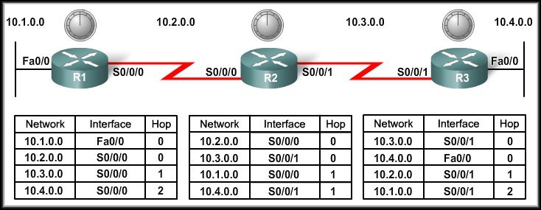
Cold Start
When a router powers up:
Knows nothing about the network topology.
Knows only the information saved in NVRAM.
Sends updates about its known networks out all ports.

Slide 18
Initial Exchange of Routing Information
10.1.0.0
Router R1:
Sends an update about network 10.1.0.0 out the Serial 0/0/0 interface with a metric of 1.
Sends an update about network 10.2.0.0 out the Fa0/0 interface with a metric of 1.
R1 sends its Routing table to the neighbouring routers !!!!

Slide 19
Initial Exchange of Routing Information
10.3.0.0
10.2.0.0
R2 sends its Routing table to the neighbouring routers !!!!
Notes:
Sends an update about network 10.3.0.0 out the Serial 0/0/0 interface with a metric of 1.
Sends an update about network 10.2.0.0 out the Serial 0/0/1 interface with a metric of 1.

Slide 20
Initial Exchange of Routing Information
10.4.0.0
R3 sends its Routing table to the neighbouring routers !!!!
Notes:
Sends an update about network 10.4.0.0 out the S0/0/0 interface with a metric of 1.
Sends an update about network 10.3.0.0 out the Fa0/0 interface with a metric of 1.

Slide 21
Initial Exchange of Routing Information
10.3.0.0
10.2.0.0
Notes:
R1 Receives the update from R2 about network 10.3.0.0 and adds it to its routing table.
R3 Receives the update from R2 about network 10.2.0.0 and adds it to its routing table.

Slide 22
Initial Exchange of Routing Information
10.1.0.0
10.4.0.0
Notes:
R2 Receives the update from R1 about network 10.1.0.0 and adds it to its routing table.
R2 Receives the update from R3 about network 10.4.0.0 and adds it to its routing table.

Slide 23
Next Exchange of Routing Information
NEW
NEW
10.3.0.0
10.4.0.0
10.1.0.0
10.2.0.0
Notes:
Sends an update about networks 10.3.0.0 with a metric of 1 and 10.4.0.0 with a metric of 2 out the Serial 0/0/0 interface.
Similarly sends updates about networks 10.1.0.0 with a metric of 2 and 10.2.0.0 with a metric of 1 out the Serial 0/0/1 interface.

Slide 24
Next Exchange of Routing Information
10.4.0.0
Notes:
Sends an update about network 10.4.0.0 out the S0/0/0 interface with a metric of 1 - AGAIN!
When R2 receives the update, there is no change in information so the update is ignored.

Slide 25
Next Exchange of Routing Information
10.3.0.0
10.4.0.0
Notes:
R1 receives an update from R2 about network 10.3.0.0 and there is no change – update ignored.
R1 receives an update from R2 about network 10.4.0.0 (new) and adds it to its routing table.

Slide 26
Next Exchange of Routing Information
10.1.0.0
10.2.0.0
Notes:
R3 receives an update from R2 about network 10.2.0.0 and there is no change – update ignored.
R3 receives an update from R2 about network 10.1.0.0 (new) and adds it to its routing table.

Slide 27
Next Exchange of Routing Information
The network has CONVERGED!
All routers now know about all of the networks attached to all of their neighbouring routers.

Slide 28
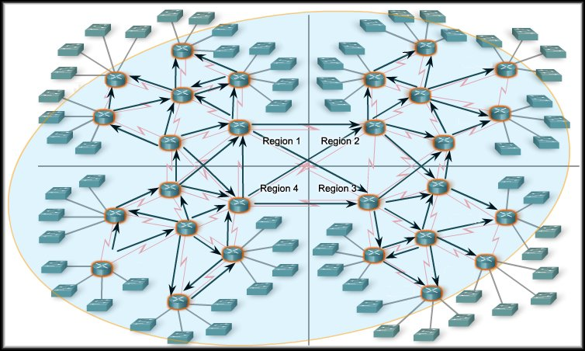
Convergence
Convergence is the time a network takes to reach a stable routing state after a change (e.g., link failure).
In general, larger networks take longer to converge.
Routing protocols are compared based on how fast they spread routing updates → this is called speed of convergence.
A network cannot forward traffic correctly until convergence is complete.
Notes:
Therefore, network administrators prefer routing protocols with faster convergence.

Slide 29
Disadvantages
Routers have only local knowledge (they know information only from neighbors).
Routers trust information received from neighbors, even if it is outdated or incorrect.
Routing updates are slow to converge after a link failure.
Incorrect routing information can spread from one router to another.
This can create routing loops.
Notes:
Therefore, network administrators prefer routing protocols with faster convergence.

Slide 30
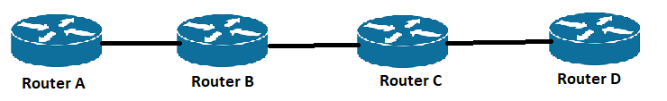

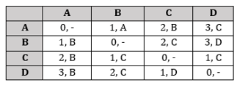
Count to infinity Problem :: Routing Loops
∞, A
Problem is:
Before B sends its routing table to C, C sends its routing table to B, where Cost(A) = 2
Notes:
As you see in this graph, there is only one link between A and the other parts of the network.
➢ Now imagine that the link between A and B is cut.
➢ At this time, B corrects its table.

Slide 31
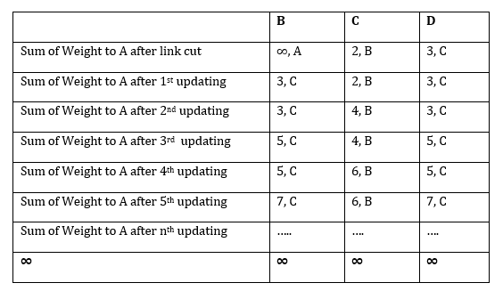
Count to infinity Problem :: Routing Loops
Routing Table of C
Since C does not know that the link between A and B is down, it assumes a path to A with cost 2 (1 from C to B and 1 from B to A).
B receives C’s table and assumes there is an alternate path to A via C
So it updates its distance to A from infinity to 3 (1 from B to C + 2 from C to A)
Once again, routers exchange their tables.

Slide 32
Count to infinity Problem :: Routing Loops
Routing Table of B
When C receives B's routing table, it sees that B has changed the weight of its link to A from 1 to 3.
So C updates its table and changes the weight of the link to A to 4 (1 for C to B, and 3 for B to A, as B said).
This process loops until all nodes find out that the weight of link to A is infinity.

Slide 33
Solution One: Split Horizon Rule
Router Information Protocol (RIP) uses this method
One way to solve this problem is that a router does not advertise a route back out the interface on which it was learned.
So, when C sends its routing table to B, it does not include any route that C learns from B

Slide 34
Solution Two: Poison Reverse Method
Poison reverse: Advertise that route back to the neighbor with an infinite metric.
Ref(if you like): Poison Reverse

Slide 35
THE END

